Slide 1

Title of the Project
TELECOMMUNICATION CHURN

Slide 2
Project Supervisor: Dr. S. Dhamodaran, M.Tech, Ph. D
Name of the Student: DANDUBOINA VENKATA MAHESH BABU
Register Number:40110287

Slide 3
Presentation Outline
Course Certificate
Introduction
Business Problem
Objectives
System Architecture / Ideation Map
Data set details
Module Implementation
Exploratory Data Analysis
Application Snapshots
Results and Discussions
Conclusion & Future work
References

Slide 4

Course Certificate

Slide 5
INTRODUCTION
We will be working on the telecom churn analysis and here we will be doing a complete EDA process to determine if the customer from that particular telecom industry will leave that telecom service or not meanwhile we will draw some insights from data visualization and analysis so that we could get the factors which will affect the output i.e. churn of the customer.

Slide 6
Business Problem
6
Telecom Churn Analysis Telecom Churn (loss of customers to competition) is a problem for telecom companies because it is expensive to acquire a new customer and companies want to retain their existing customers.
In this highly competitive market, the telecommunications industry experiences an average of 15-25% annual churn rate. Given the fact that it costs 5-10 times more to acquire a new customer than to retain an existing one, customer retention has now become even more important than customer acquisition.

Slide 7
Objectives
Churn analytics is the process of measuring the rate at which customers quit the product, site, or service. It answers the questions “Are we losing customers?” and “If so, how?” to allow teams to take action. Lower churn rates lead to happier customers, larger margins, and higher profits.
Finding out the best model for our business case & providing executive summary.

Slide 8
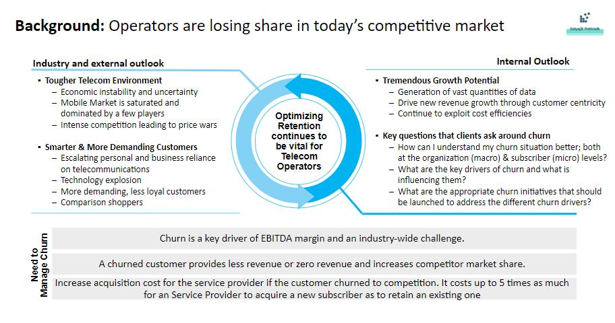
8

Slide 9
System Architecture/ Ideation Map
Data cleansing
Duplicate values removal
Missing values treatment
EDA
Univariate Analysis
Data pre processing
Data type conversion
Normalization/Standardization
Bivariate Analysis
Model building
Decision Tree Classifier
Random Forest classifier
Datavisualisation

Slide 10
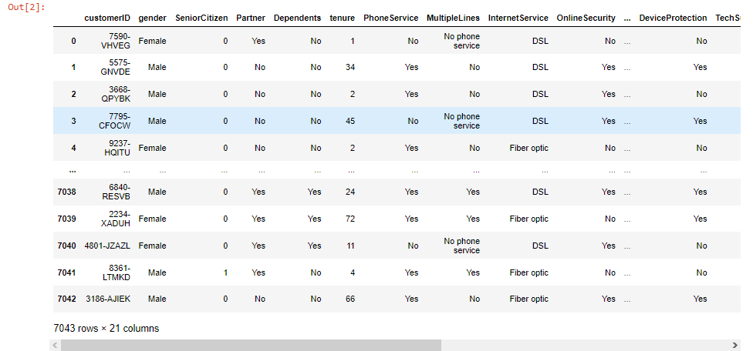
Data set details
10
Data set: Telco customer data
7043 Observations & 21 features
There is no missing values for the provided input dataset
Churn is the variable which notifies whether
a particular customer is churned or not

Slide 11
Project Implementation
PROBLEM STATEMENT : Prediction of whether customer will churn from than company ot not.
HARDWARE REQUIREMENTS : PC or Laptop Mouse Keyboard SOFTWARE
REQUIREMENTS : Anaconda Navigator Python3 Jupyter Notebook Spyder Software.
DATA COLLECTION : Data anlysis depends heavily on data, it is the most crucial aspect that makesus understand the problem statement of given project. So need to download the dataet and import the dataet into Jupyter Notebook

Slide 12
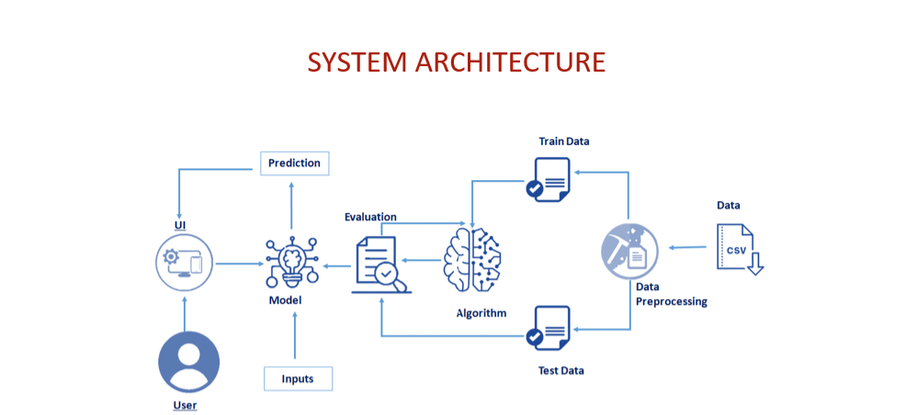
System Architecture

Slide 13
Exploratory Data Analysis
12
Exploratory Data Analysis is an approach to analyse the datasets to summarize their main characteristics in form of visual methods.
EDA is nothing but an data exploration technique to understand various aspects of the data.
The main aim of EDA is to obtain confidence in a data to an extent where we are ready to engage a machine learning model
EDA is important to analyse the data it’s a first steps in data analysis process.

Slide 14
13
Exploratory data analysis is important for business process because we are preparing dataset for deep through analysis that will detect you business problem.

Slide 15
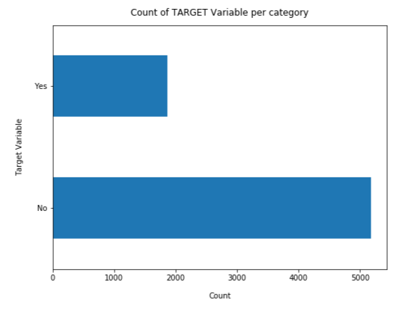
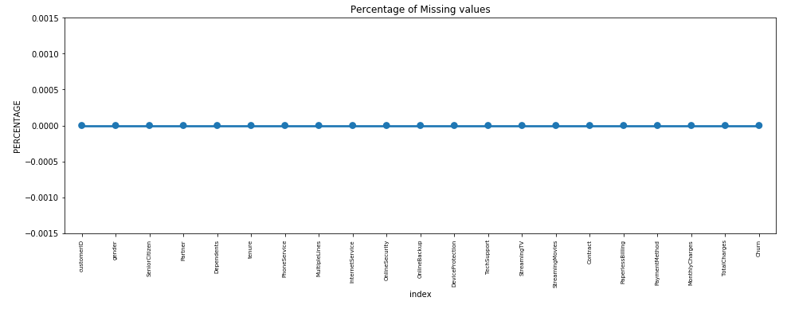
Sample Snapshot
Bar Graph
Point Plot

Slide 16
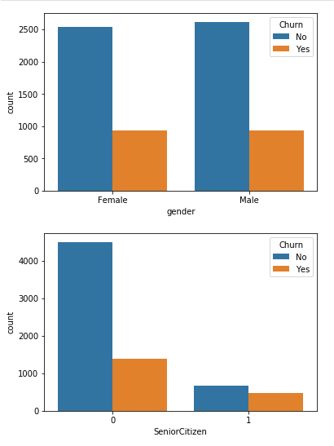
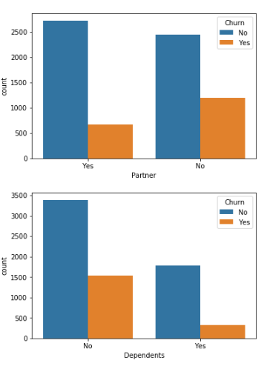
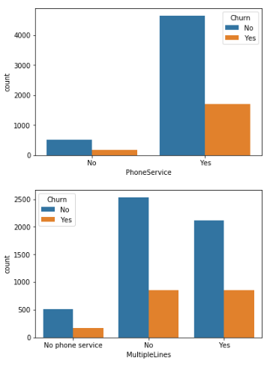
Univariate analysis
15
Count Plot

Slide 17
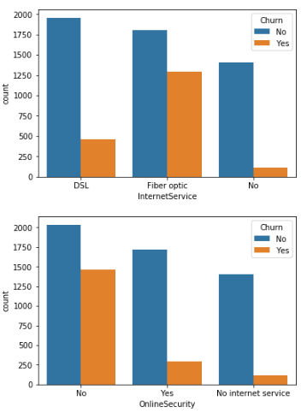
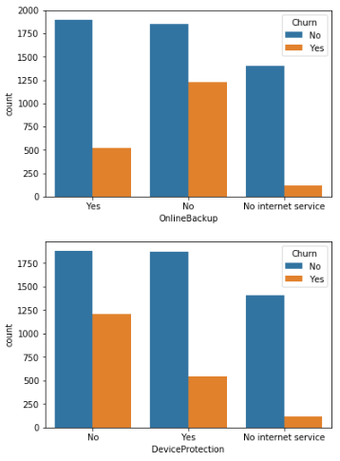
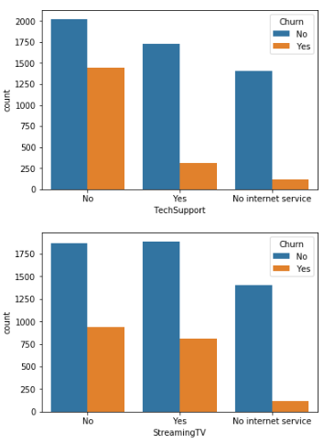
16

Slide 18
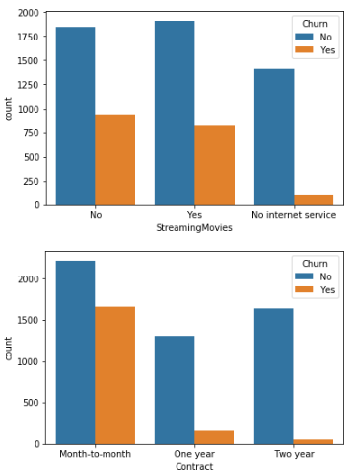
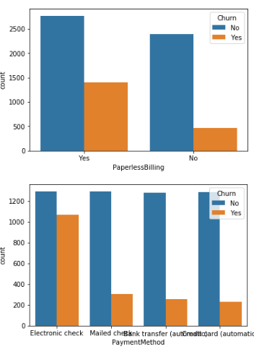
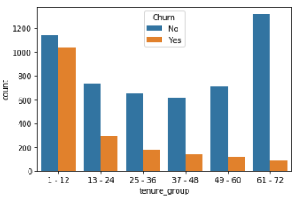
17

Slide 19
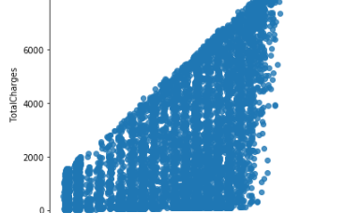
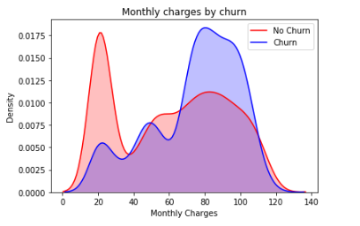
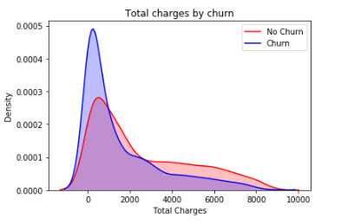
18
LM Plot
KDE Plot
KDE Plot
Total charges vs Monthly charges

Slide 20
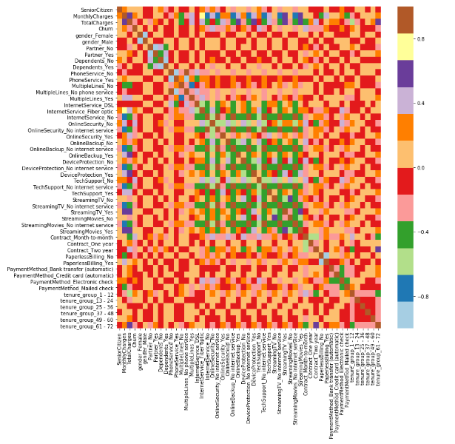
Heat Map
20
Correlation : Dependence or association is any statistical relationship, whether casual or not, between two random variables or bivariate data.
With the help of correlation matrix, we can find interdependency between variables.
Least dependency of variables for predicting churn are tenure and contract.
Churn variable is depending more on monthly charges.

Slide 21
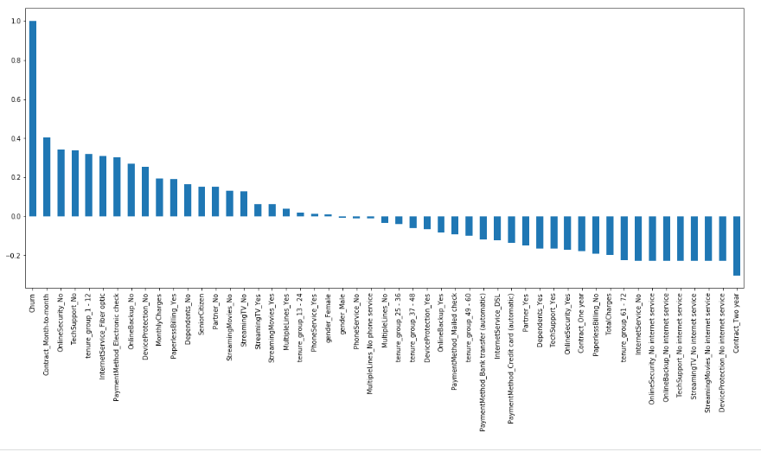
19

Slide 22
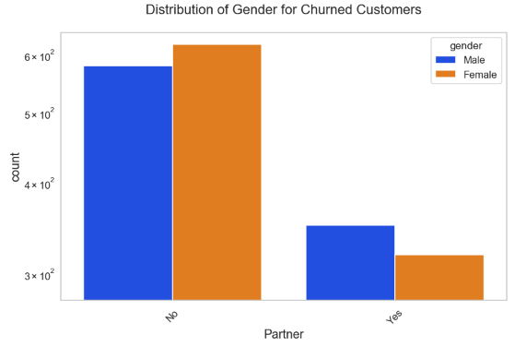
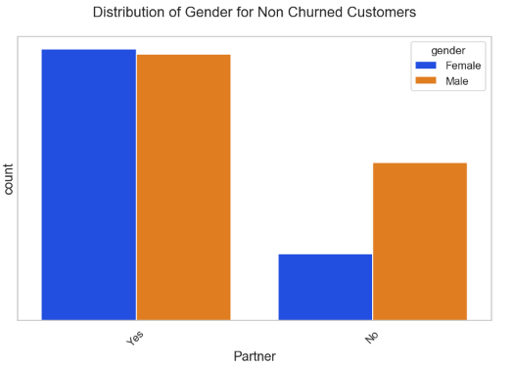
21
Bivariate Analysis
Count plot

Slide 23
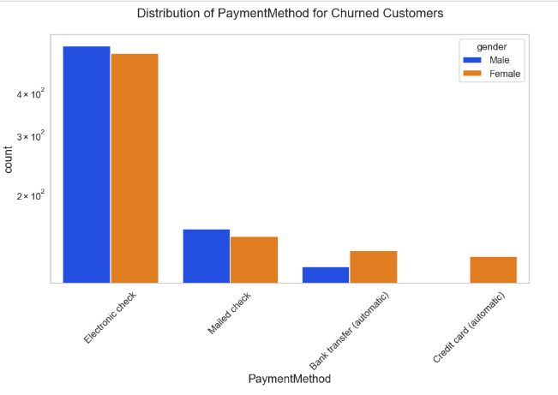
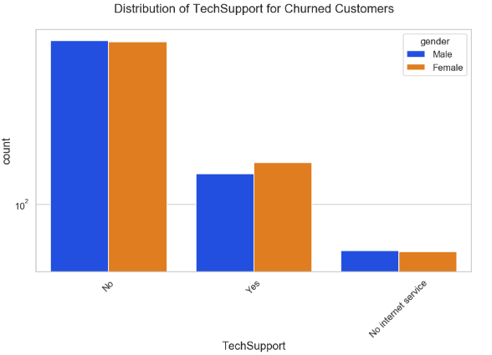
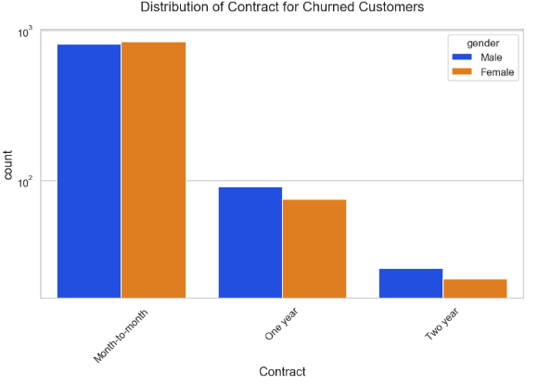
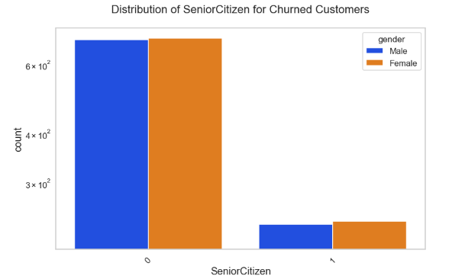
22

Slide 24
Results and Discussion
After the completion of EDA, we found some extremely useful and interesting insights and results.
Firstly, Senior Citizen is categorical hence the 25%-50%-75% distribution is not proper.
Secondly, Higher Monthly charges, Lower tenure, and Lower Total charges are linked to High Churn.
Thirdly, HIGH Churn has seen in case of Month-to-month contracts, No online security, No Tech support, First year of subscription, and Fiber Optics Internet.

Slide 25
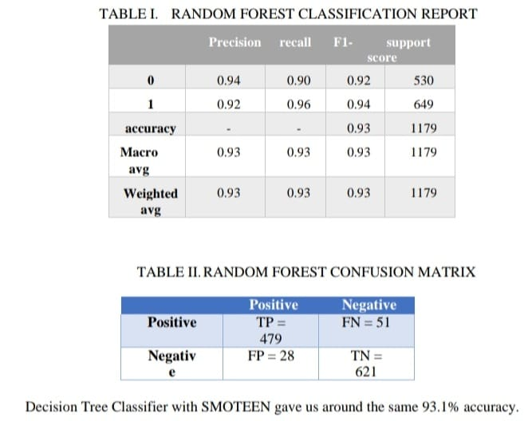
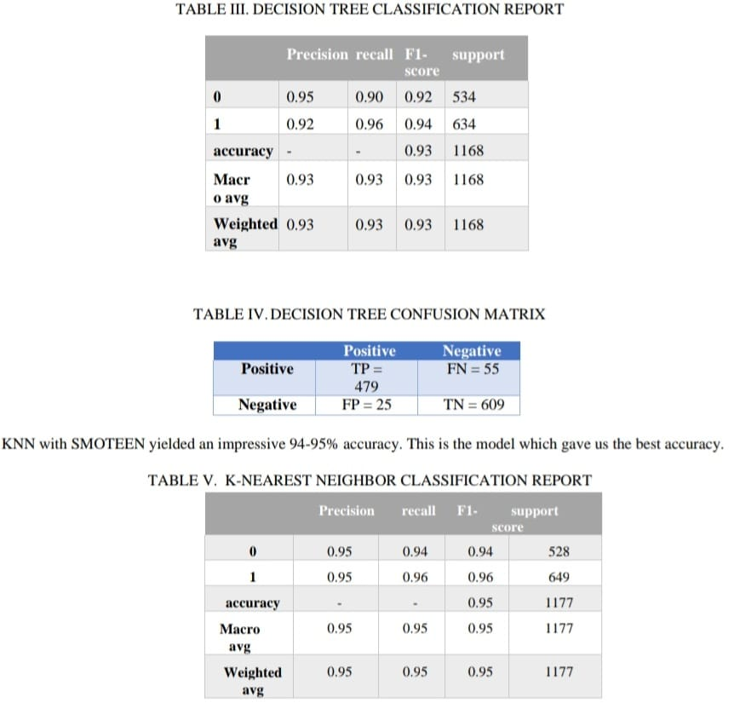

Slide 26
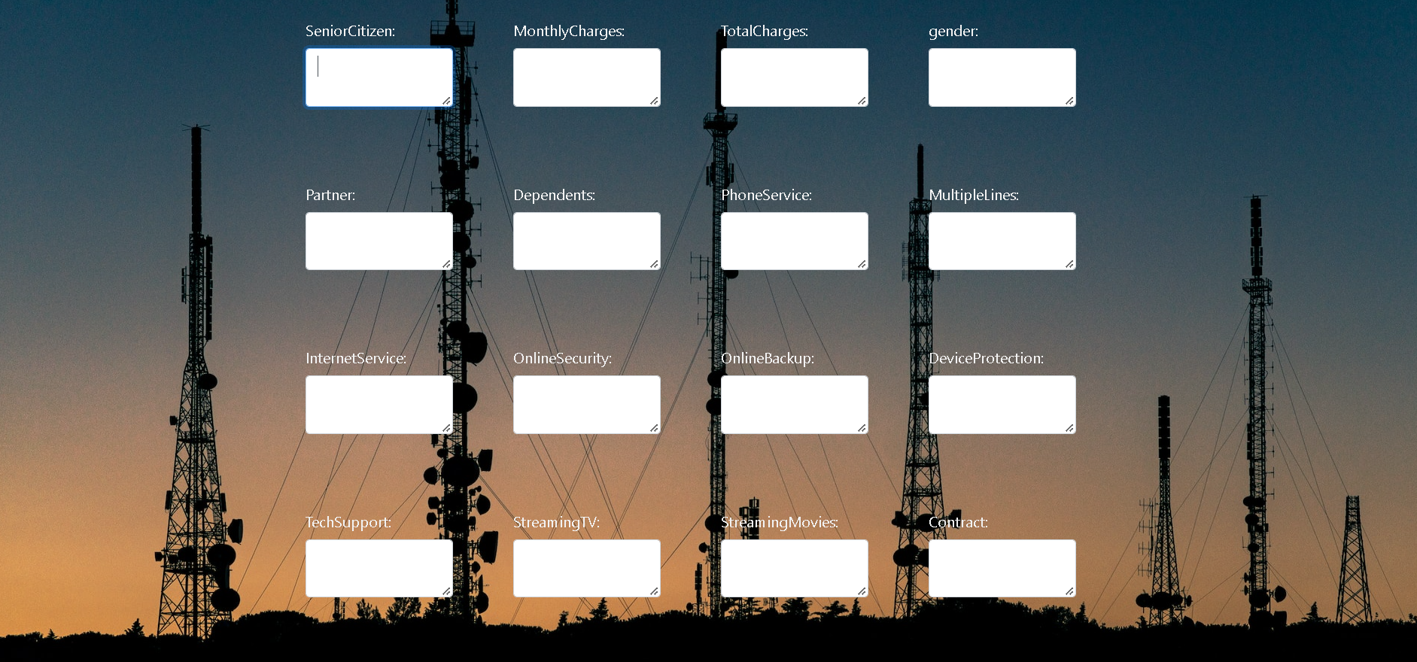

Slide 27
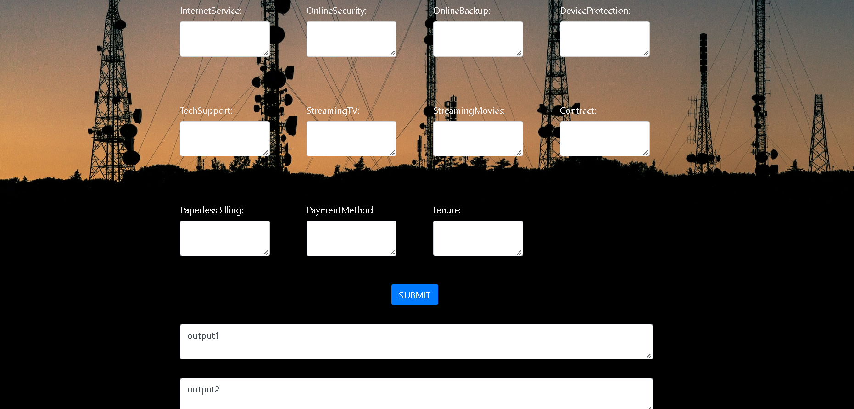

Slide 28
Fourthly, LOW Churn is seen in the case of Long-term contracts, Subscriptions without internet service, and the customers engaged for 5+ years. Fifth, Factors like Gender, Availability of phone service and the number of multiple lines have almost NO impact on Churn
Take aways from the given result:
First and foremost data and information security is the most priority for a lot of people .In these days adding cybersecurity features like , Two factor authentication can seamlessly help through online transactions ,streaming and Data sharing .
Secondly creation of a ecosystem – a telecom company nowadays provides lot of services like Broadband ,streaming ,banking and muck more .If the company can attract all its customers to use all of these features and get loyalty rewards.

Slide 29
Conclusion
These are some of the quick insights from this exercise:
Electronic check medium are the highest churners
Contract Type - Monthly customers are more likely to churn because of no contract terms, as they are free to go customers.
No Online security, No Tech Support category are high churners
Non senior Citizens are high churners

Slide 30
References
B. Oghojafor, G. Mesike, R. Bakarea, C. Omoera, and I. Adeleke, “Discriminant analysis of factors affecting telecoms customer churn,” International Journal of Business Administration, vol. 3, no. 2, p. 59, 2012.
M. Tokman, L. M. Davis, and K. N. Lemon, “The WOW factor: creating value through win-back offers to reacquire lost customers,” Journal of Retailing, vol. 83, no. 1, pp. 47–64, 2007.
F. F. Reichheld and W. E. Sasser, “Zero defections: quality comes to services,” Harvard Business Review, vol. 68, no. 5, pp. 105–111, 1990.

Slide 31
Almuqren, Latifah, Fatma S. Alrayes, and Alexandra I. Cristea. 2021. "An Empirical Study on Customer Churn Behaviours Prediction Using Arabic Twitter Mining Approach" Future Internet 13, no. 7: 175. https://doi.org/10.3390/fi13070175.
Data virtualization help from: https://www.kaggle.com/learn
Project ideology from: https://www.kaggle.com/datasets/dhanushu2012/project-telecommunication-customer-churn

Slide 32
THANK YOU

